Slide 1
College of Science

Slide 2
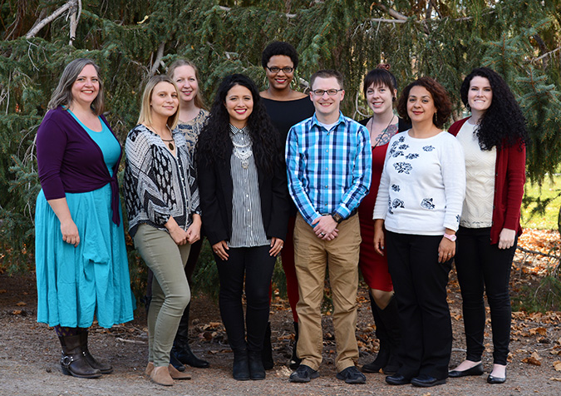
Advisors are here to help!

Slide 3
Scheduling in the Sciences
Prerequisites
Which science courses have prerequisites? ALL of them!
General Education
Spread general education over all 4 years
Science LEAP!

Slide 4
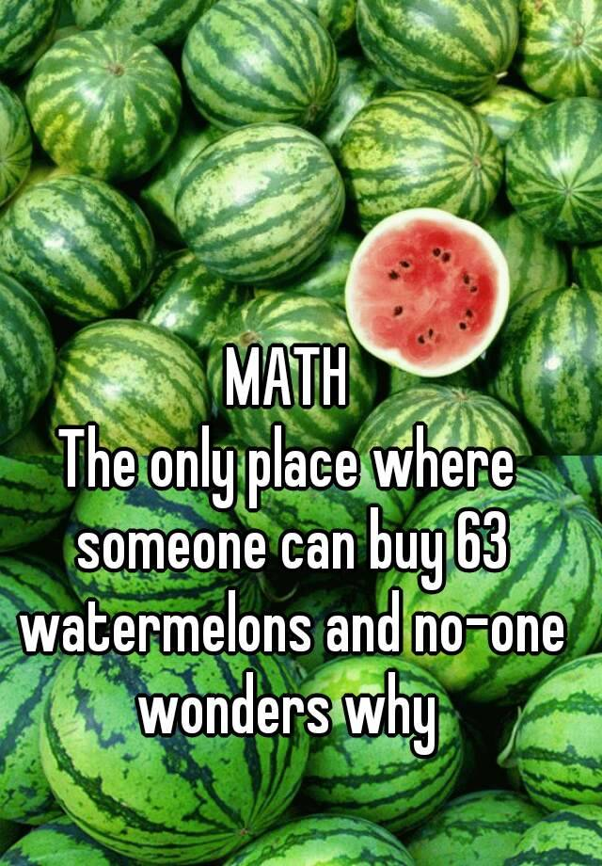
Math Course Sequencing
Math 980 → Math 1010 → Math 1050 → Math 1060 → Math 1210 (Calc I)
Math 1080
Math 1030, 1040, 1070, 1090
DON’T TAKE THEM

Slide 5
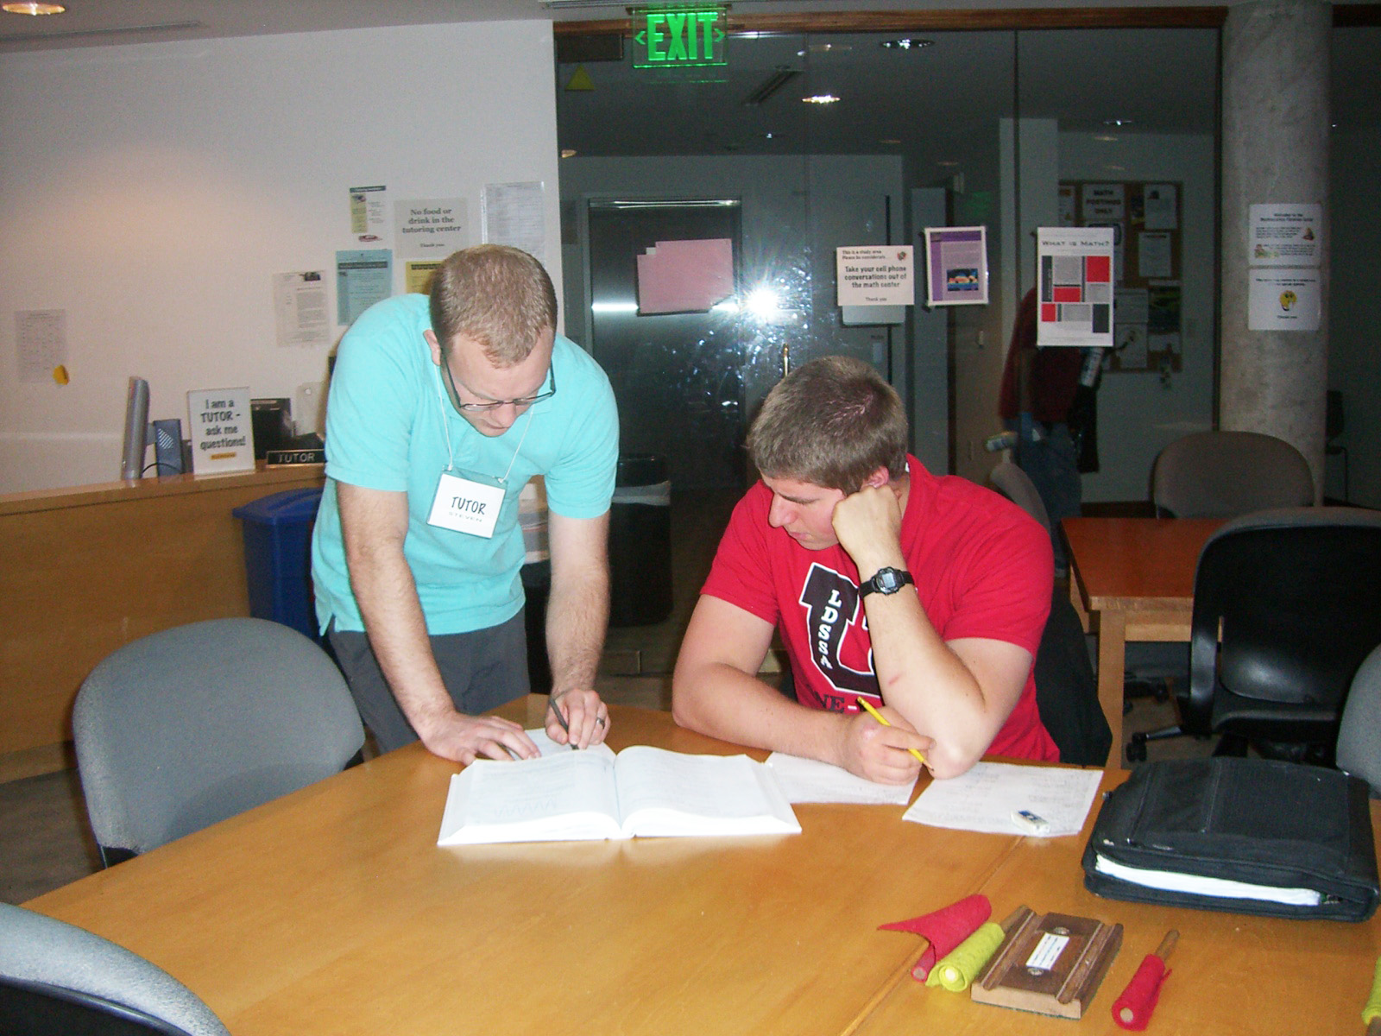
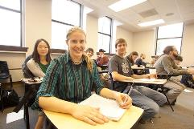
Student Opportunities
Tutoring Centers in every department
Get help with coursework
Work as a tutor
Work as a lab or teaching assistant

Slide 6
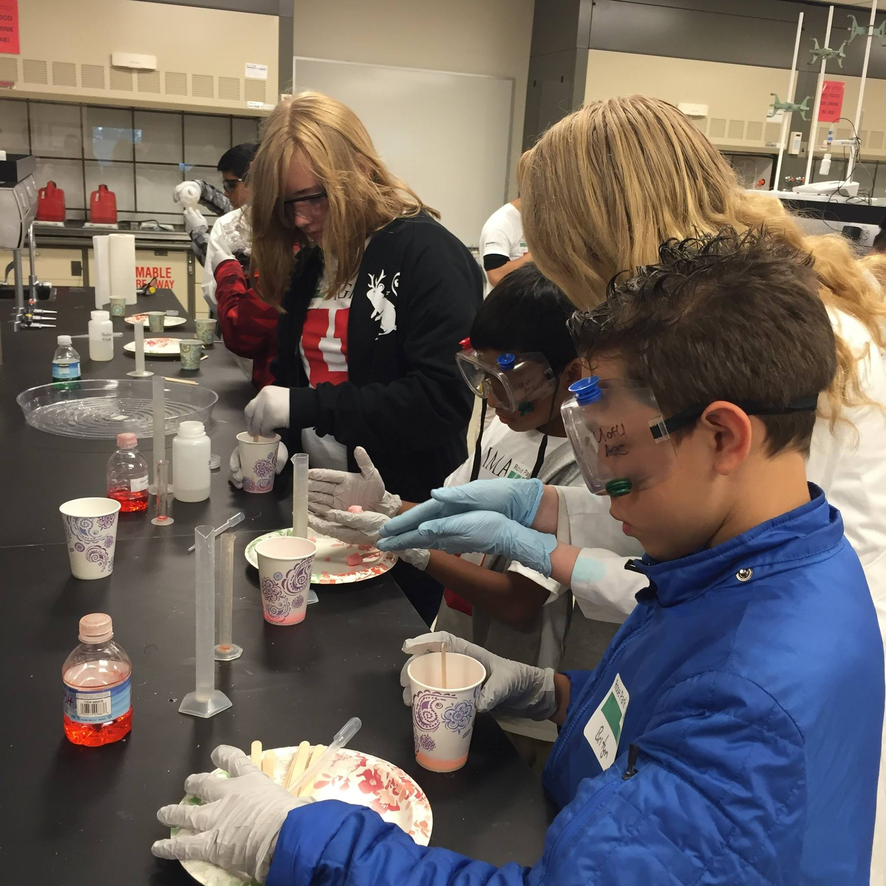
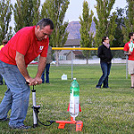
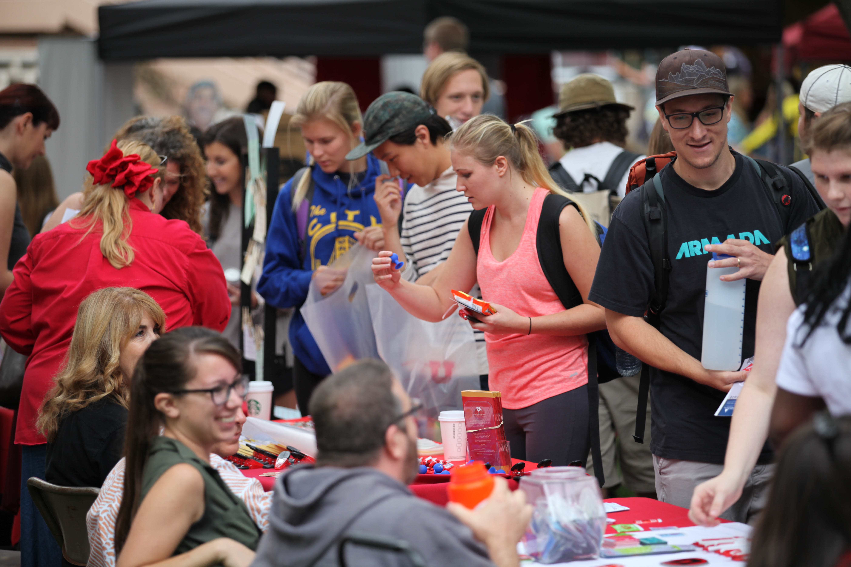
Student Opportunities
Student Organizations
Association for Women in Mathematics – AWM
Society for Industrial and Applied Mathematics – SIAM
American Chemical Society – ACS
Society of Physics Students – SPS
Women in Physics & Astronomy – WomPA
Bioscience Undergraduate Research Club (BSURC)
In-STEM
And more….

Slide 7
College of Science Instagram
https://www.instagram.com/uofu_science/
College of Science, in-STEM, Facebook
https://www.facebook.com/groups/inSTEMcos/

Slide 8
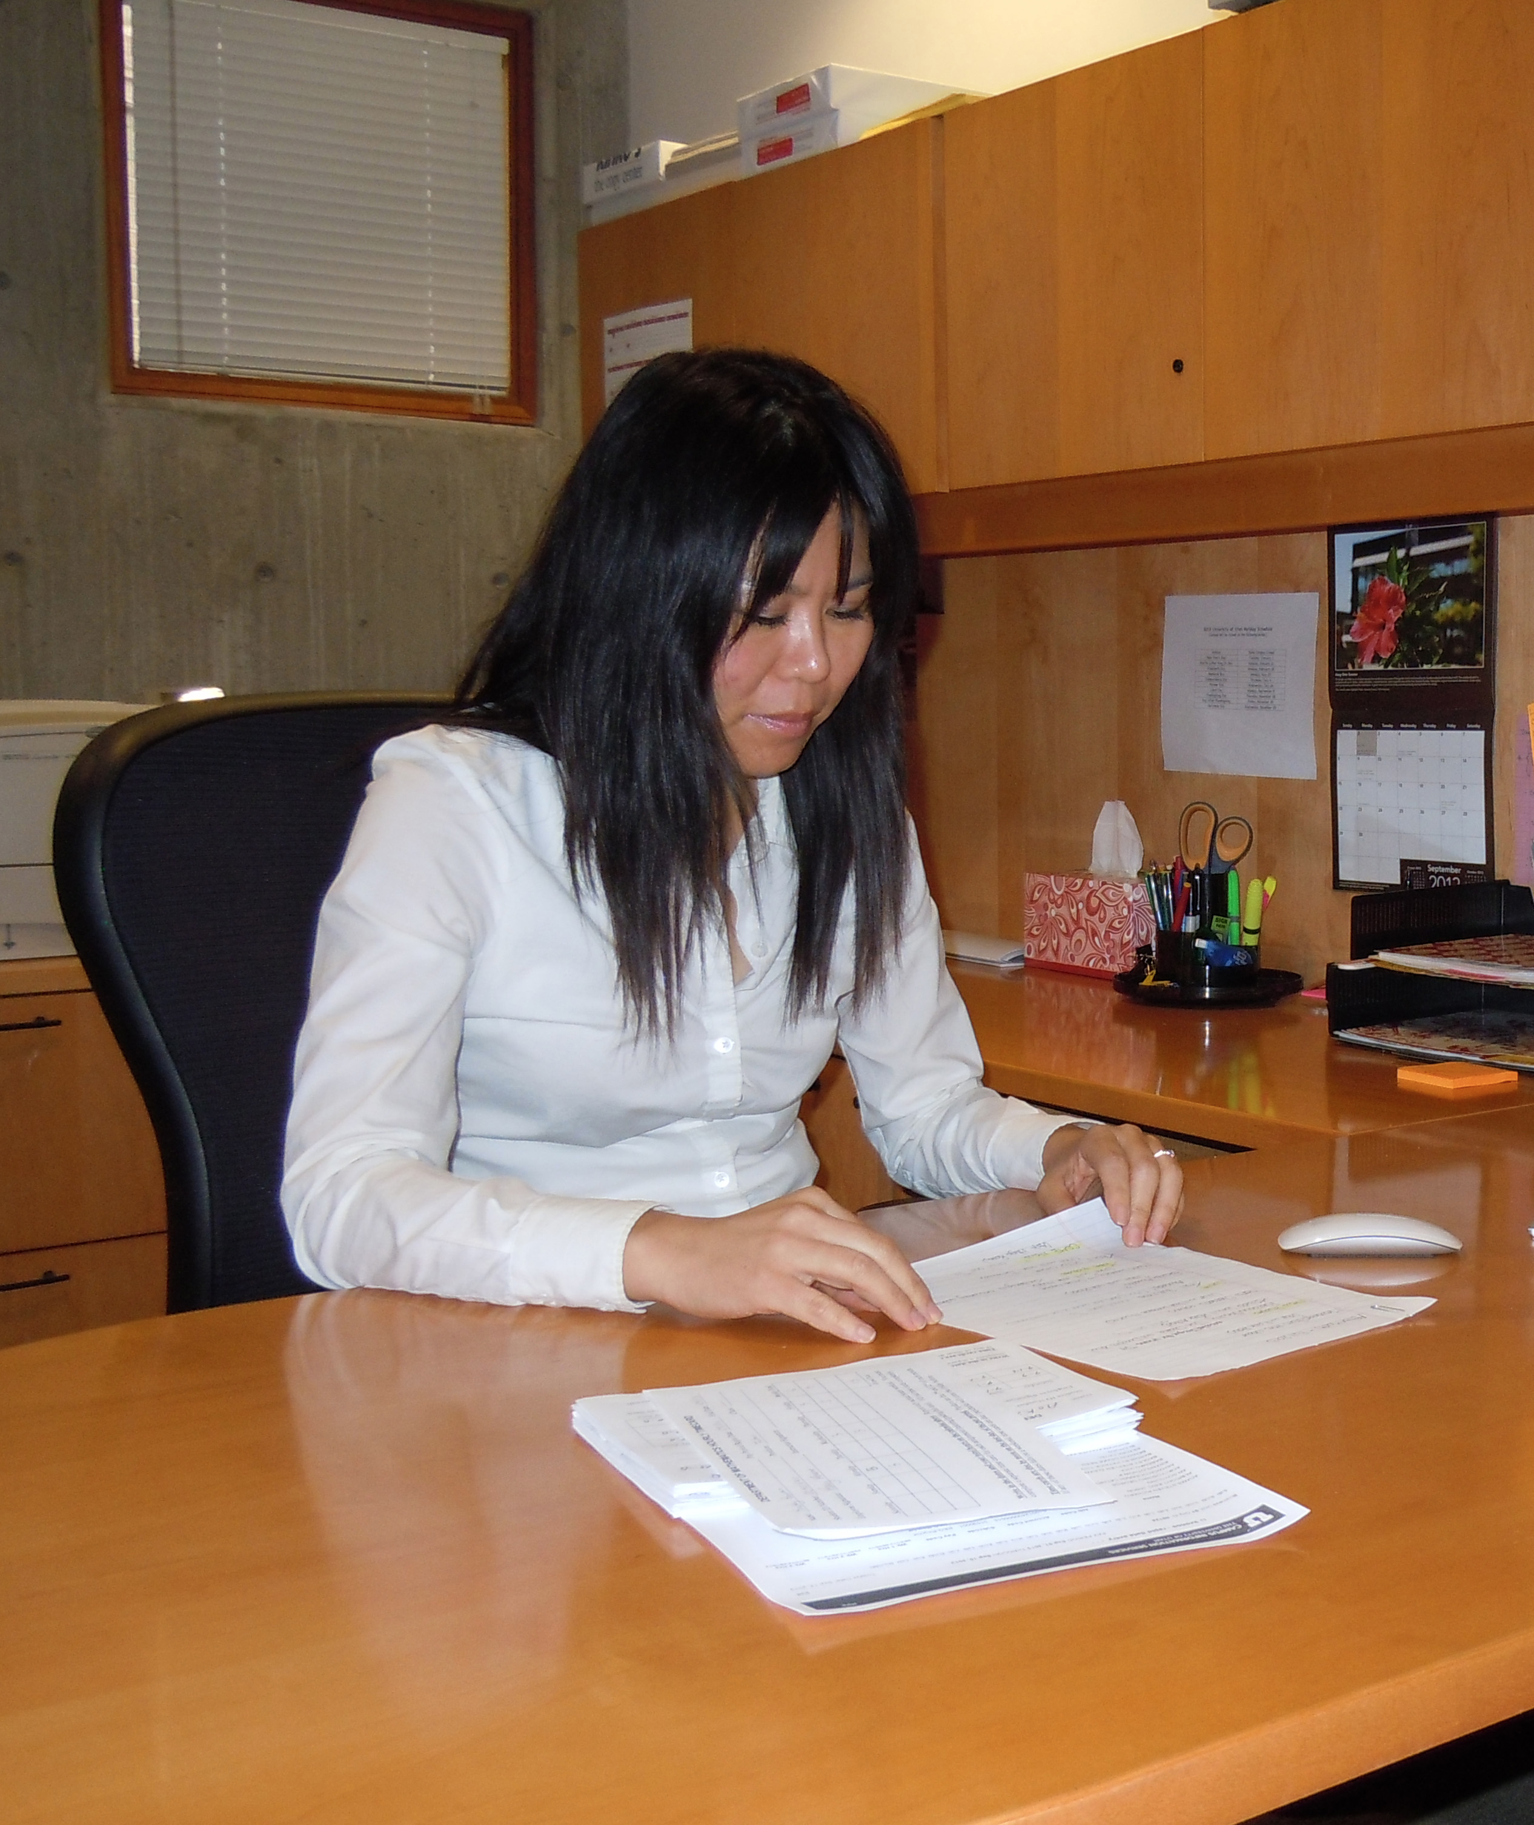
Internship Opportunities
Gain real world experience
in an internship

Slide 9
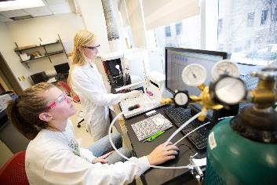
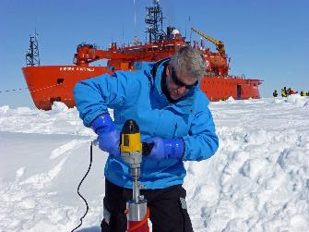
Research Opportunities
Work with distinguished faculty on cutting edge research as an undergraduate!

Slide 10
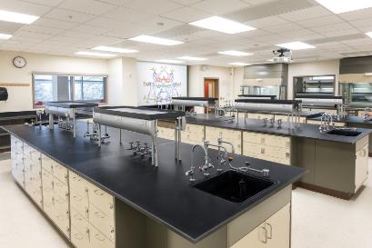
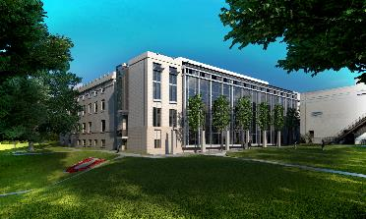
Crocker Science Center
The Crocker Science Center brings new educational opportunities, new interdisciplinary research collaborations, and a new kind of science community to the U of U campus, Salt Lake City, and the State of Utah.

Slide 11
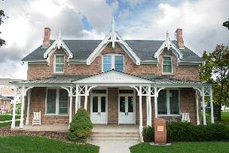
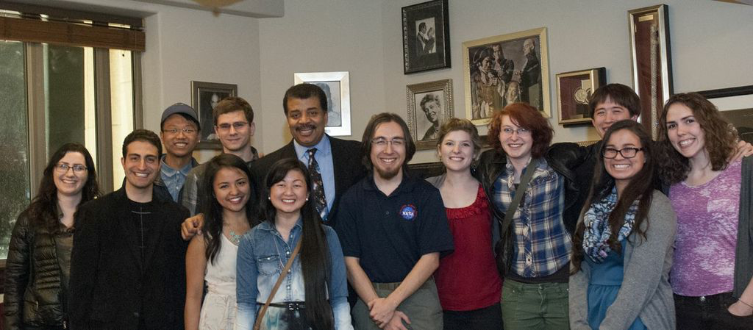
Crocker Science House
Twelve undergraduate students
A unique living, learning community
Special events for residents

Slide 12
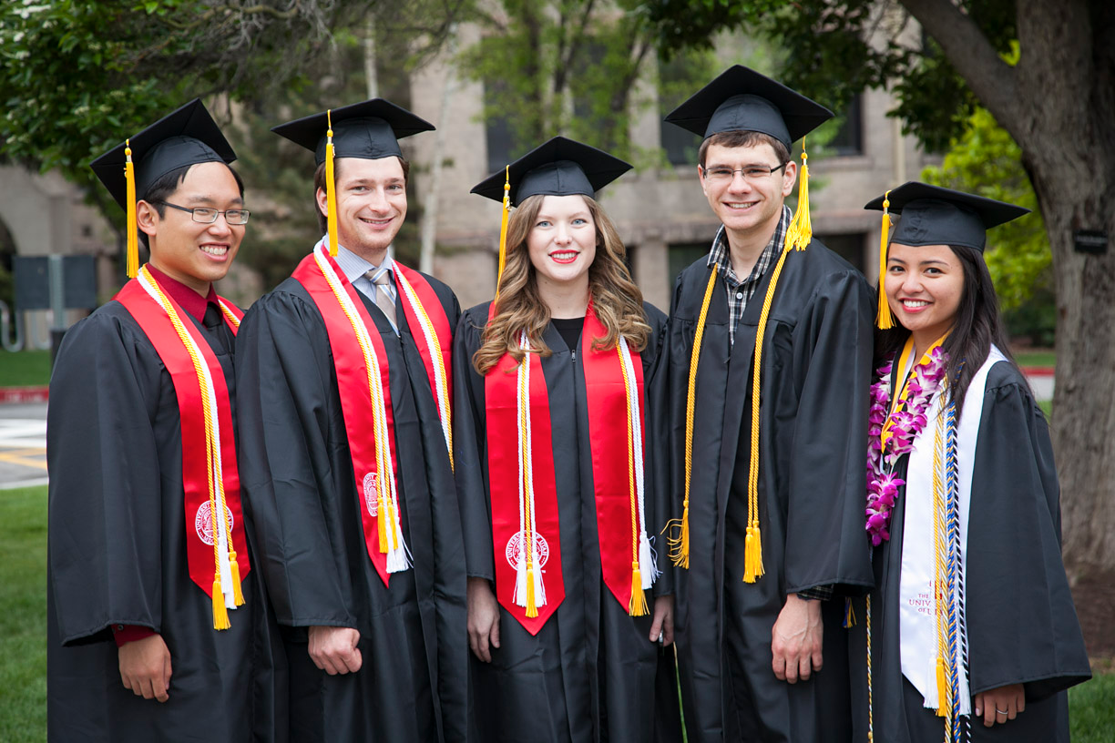
College of Science

